Slide 1
Managing Background Traffic in Cellular Networks
Shanyu Zhou*, Muhammad Usama Chaudhry*, Vijay Gopalakrishnan†, Emir Halepovic†, Balajee Vamanan*, and Hulya Seferoglu*
*University of Illinois at Chicago (UIC), †AT&T Labs – Research
All presented information does neither reflect nor imply an actual business case for AT&T and associated companies.
They are generalized data used to assess performance of the algorithms only
© 2019 AT&T Intellectual Property. AT&T, Globe logo, and DIRECTV are registered trademarks and service marks of
AT&T Intellectual Property and/or AT&T affiliated companies. All other marks are the property of their respective owners.

Slide 2



Managing Background Traffic in Cellular Networks
Motivation
  Cellular network connectivity is ubiquitous
  Management of the scarce cellular bandwidth is crucial
  New applications -- software updates, cloud sync etc.
    competing with existing applications -- browsing, video streaming
Critical to develop traffic management mechanisms that can handle large volumes of traffic with diverse characteristics
Notes:
In this era of ubiquitous cellular network connectivity, management of the scarce cellular bandwidth is important. A number of new applications (e.g., software updates, cloud sync) are starting to compete with existing applications (e.g., web browsing, video streaming) for cellular bandwidth. Therefore, it is critical to develop traffic management mechanisms that can handle large volumes of traffic with diverse characteristics.

Slide 3
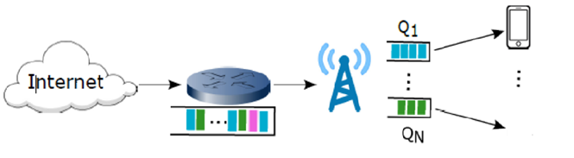

Managing Background Traffic in Cellular Networks
Motivation
  Approach: Partition flows into two classes
  Foreground traffic. Regular mobile traffic like human communication or even some time-sensitive machine-to-machine (M2M) flows (e.g., alarms, health monitoring)
  Background traffic. Large volume, time insensitive flows (e.g., software downloads to smart vehicles)
Video streaming
Foreground
Software download
Background
Notes:
One way to tackle the problem of managing such diverse traffic is to partition flows into two classes: foreground and background flows (although it is straightforward to extend the approach to more than two classes). In this paper, we broadly consider regular mobile traffic like human communication or even some time-sensitive machine-to-machine (M2M) flows (e.g., alarms, health monitoring) as foreground traffic, while treating large volume, time insensitive flows (e.g., software downloads) as background traffic. Our goal then is to design a traffic management approach for cellular networks that prioritizes foreground traffic during periods of congestion while scheduling background traffic to effectively utilize any spare capacity. We also focus on a solution for downlink because most large volume traffic flows in the downlink direction.

Slide 4
Managing Background Traffic in Cellular Networks
Motivation
  Goal:
  Design a traffic management approach for cellular networks
    Prioritize foreground traffic during periods of congestion
    Schedule background traffic to effectively utilize any spare capacity
Video streaming
Foreground
Urgent
Software download
Background
Non-urgent
© 2019 AT&T Intellectual Property. AT&T, Globe logo, and DIRECTV are registered trademarks and service marks of AT&T Intellectual Property and/or AT&T affiliated companies. All other marks are the property of their respective owners.
Notes:
Our goal then is to design a traffic management approach for cellular networks that prioritizes foreground traffic during periods of congestion while scheduling background traffic to effectively utilize any spare capacity. We also focus on a solution for downlink because most large volume traffic flows in the downlink direction.

Slide 5
Managing Background Traffic in Cellular Networks
State-of-the-art
  In-network. Cellular networks provide support for prioritization using QoS Class Identifier (QCI)
    QCI suffers from several limitations:
      Identifies only at the granularity of devices or radio bearers
      Offers only a handful traffic classes, many of which are reserved for operator-provided services like voice
      Uses static weights for the classes independent of network load
  End-to end. Low priority transport protocols (e.g., TCP-LP)
    Poor performance in cellular networks although perform well in WiFi.
© 2019 AT&T Intellectual Property. AT&T, Globe logo, and DIRECTV are registered trademarks and service marks of AT&T Intellectual Property and/or AT&T affiliated companies. All other marks are the property of their respective owners.
Notes:
There are existing in-network and end-to-end approaches to manage foreground and background traffic. Today’s cellular networks provide support for prioritization using QoS Class Identifier (QCI). However, QCI suffers from several limitations: (1) identifies only at the granularity of devices or radio bearers, (2) offers only a handful traffic classes, many of which are reserved for operator-provided services like voice and VoLTE, and (3) uses static weights for the classes independent of network load. As an alternative, end-to-end, low-priority transport protocols (e.g.,TCP-LP [1]) perform well in wired and W i-F i networks but suffer in cellular networks due to per-device
queues and schedulers. To summarize, existing in-network approaches do not prioritize at flow granularity and existing end-to-end approaches are not effective in cellular networks.

Slide 6
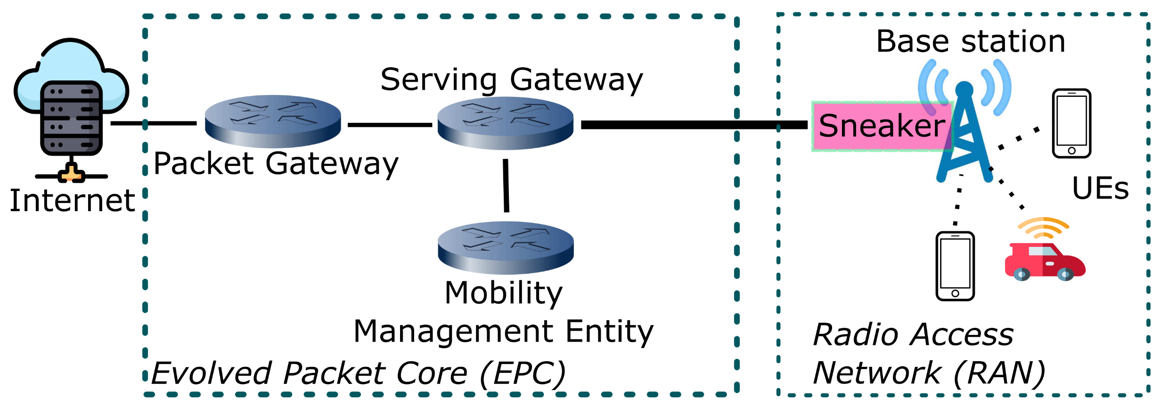
Our Solution: Sneaker
  Randomly dropping packets from background traffic
  Compatible with existing network schedulers at the base station
Notes:
We consider the general architecture of LTE cellular networks as shown in Fig. 1, with two parts; evolved packet core (EPC) and radio access networks (RAN). The evolved packet core is a high-speed wired network that comprises the Mobility Management Entity (MME), the Serving Gateway (SGW), and the Packet Data Network Gateway (PGW). The LTE RAN includes the eNobeB (base station) and User Equipment (UE), which could be cellphones, tablets, connected vehicles, etc. Traffic from remote hosts in the Internet traverses through the packet core, arrives at the base station and eventually reaches the end users through wireless channels. In this setup, we develop Sneaker at base stations that works with existing TCP and cellular scheduling protocols and prioritizes foreground traffic over background.

Slide 7
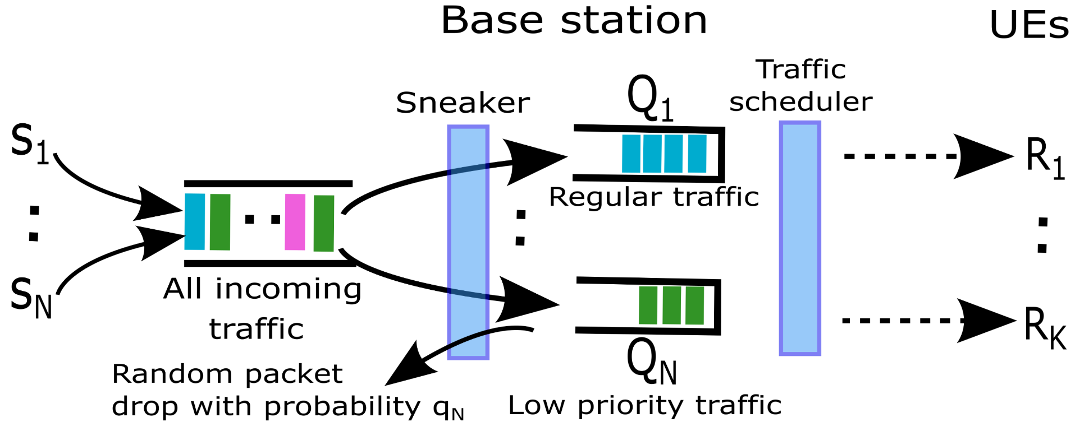
System Model
Example cellular system with Sneaker
Remote hosts
Per-flow
queues
PFS, MT,
RR, etc.
TCP-Reno
(b) Queue II
Notes:
Flows. We consider a system model depicted in Figure 2, which represents the RAN from Figure 1. There are N flows destined to K users within the same radio cell. M of these flows are foreground, while L of them are background flows (i.e., N = M +L). The set of all flows is S = {S1, …, SN}.
Queuing Model. At the base station, packets are queued in per-flow queues; {Q1, … QN}. Packets from flow Sn are
stored in queue Qn. These queues operate according to the First-Come First-Serve (FCFS) rule.
Channel Model. We consider that base station back-haul links are high speed and lossless. The bottleneck of the system is the last hop radio channel; a radio frequency carrier shared by a set of cellular devices. We consider that cn(t) denotes the downlink channel capacity of device n at time t, which is the maximum achievable data rate based on the channel characteristics, as determined by the base station.
Scheduler. At the base station, time is divided into Transmission Time Intervals (TTIs), and each TTI is usually 1 ms in LTE [3]. The scheduler determines which packets should be transmitted from the base station at a given TTI. Proportional Fair scheduler (PFS) is one of the widely used schedulers in today’s cellular systems [4]. The other popular schedulers are
Maximum Throughput (MT), Round Robin (RR), Blind Equal Throughput (BET), Throughput to Average (TTA), etc [5].

Slide 8
System Model
Problem statement
Remote hosts
  Problem: Determine optimal dropping rate.
    Forces background traffic to quickly yield to foreground traffic when network congested
    Allows it quickly recapture spare capacity when network load subsides
(b) Queue II
Notes:
Problem Statement. Our goal is to develop a method that works with existing transport layer protocols and scheduling algorithms to prioritize foreground traffic over background. Our approach is to achieve the desired goal by randomly dropping packets coming into the base station, based on traffic type – foreground or background. In this context, the fundamental problem is to determine the optimal dropping rate. In this paper, we determine the optimal dropping rate that forces background traffic to quickly yield to foreground traffic when the network is congested, but allows it to quickly recapture spare capacity when network load subsides.

Slide 9

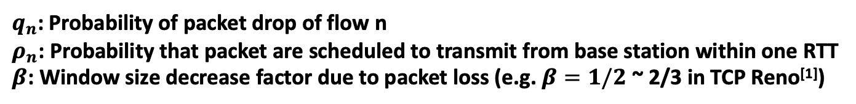
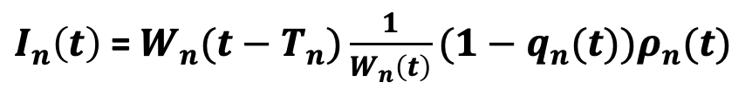
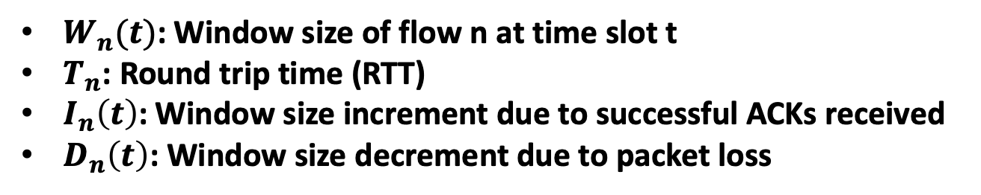
Interaction of TCP with Cellular Networks
$W_{n}(t)$: Window size of flow n at time slot t
$T_{n}$: Round trip time (RTT)
$I_{n}\left(t\right)$: Window size increment due to successful ACKs received
$D_{n}\left(t\right)$: Window size decrement due to packet loss
$$W_{n}\left(t+T_{n}\right)= W_{n}\left(t\right)+ I_{n}\left(t\right)− D_{n}(t)$$
$I_{n}\left(t\right)$ = $W_{n}(t−T_{n})\frac{1}{W_{n}\left(t\right)}(1−q_{n}(t))ρ_{n}(t)$
$D_{n}\left(t\right)$ = $W_{n}(t−T_{n})β W_{n}(t)(1−\left(1−q_{n}\left(t\right)\right)ρ_{n}\left(t\right))$
$q_{n}$: Probability of packet drop of flow n
$ρ_{n}$: Probability that packet are scheduled to transmit from base station within one RTT
$β$: Window size decrease factor due to packet loss (e.g. $β=1/2$ ~ 2/3 in TCP Reno^{[1]})
[1] Srikant, Rayadurgam, and Lei Ying. Communication networks: an optimization, control, and stochastic networks perspective. Cambridge University Press, 2013.

Slide 10

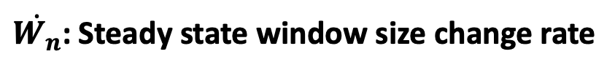
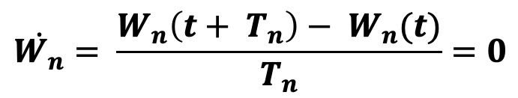
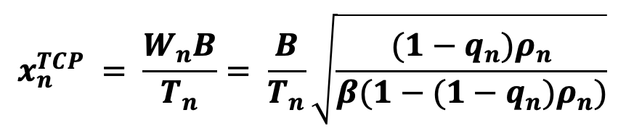
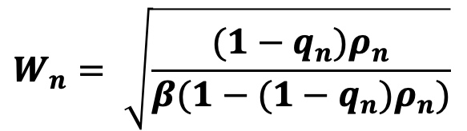
Interaction of TCP with Cellular Networks
$$\dot{W_{n}}= \frac{W_{n}\left(t+ T_{n}\right)− W_{n}(t)}{T_{n}}=0$$
$$W_{n}= \sqrt{\frac{(1−q_{n})ρ_{n}}{β(1−(1−q_{n})ρ_{n})}}$$
$$x_{n}^{TCP} = \frac{W_{n}B}{T_{n}}= \frac{B}{T_{n}}\sqrt{\frac{(1−q_{n})ρ_{n}}{β(1−(1−q_{n})ρ_{n})}}$$
$\dot{W_{n}}$: Steady state window size change rate
$B$: Typical TCP packet size
$x_{n}$: Steady state TCP throughput

Slide 11
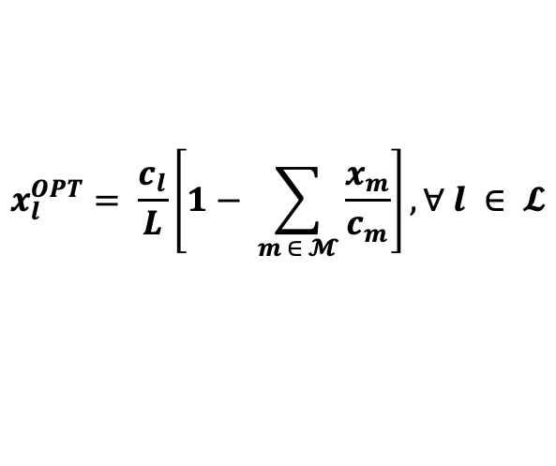
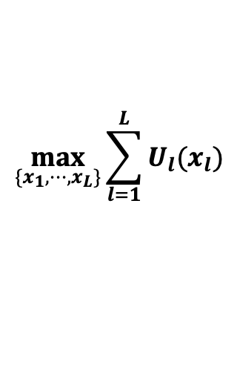
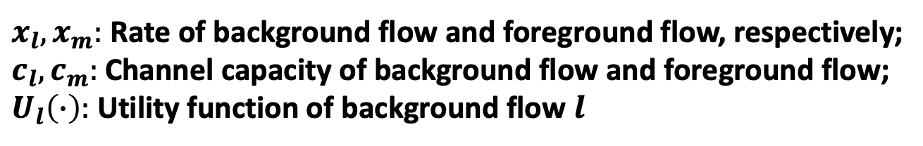

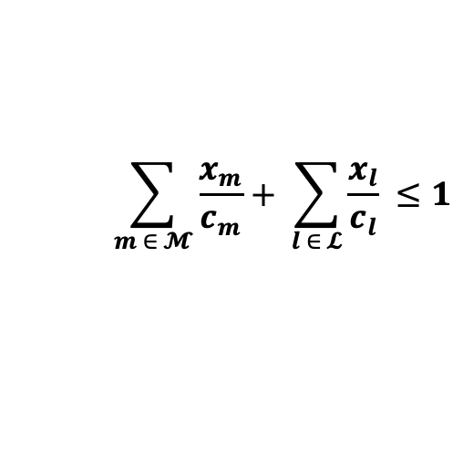

Design of Sneaker
Network Utility Maximization (NUM) formulation
$$\max_{\{x_{1},⋯,x_{L}\}}{\sum_{l=1}^{L}{U_{l}(x_{l})}}$$
$$\sum_{m ∈ 𝓜}{\frac{x_{m}}{c_{m}}}+ \sum_{l ∈ 𝓛}{\frac{x_{l}}{c_{l}}} ≤1$$
$$s.t.$$
$$x_{l} ≥0, ∀ l ∈ 𝓛$$
$x_{l}, x_{m}:$ Rate of background flow and foreground flow, respectively;
$c_{l}, c_{m}:$ Channel capacity of background flow and foreground flow;
$U_{l}\left(∙\right):$ Utility function of background flow $l$
$$x_{l}^{OPT}= \frac{c_{l}}{L}\left[1− \sum_{m ∈ 𝓜}{\frac{x_{m}}{c_{m}}}\right], ∀ l ∈ 𝓛$$

Slide 12
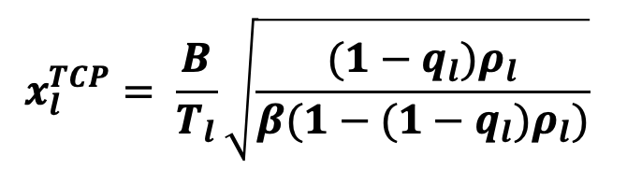
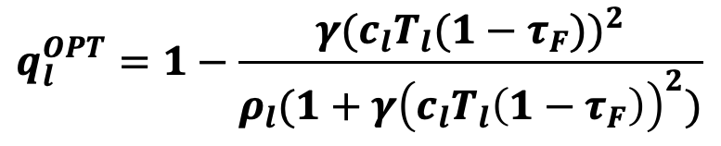


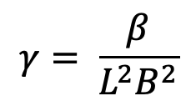
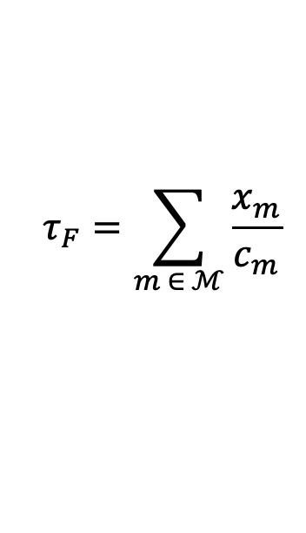
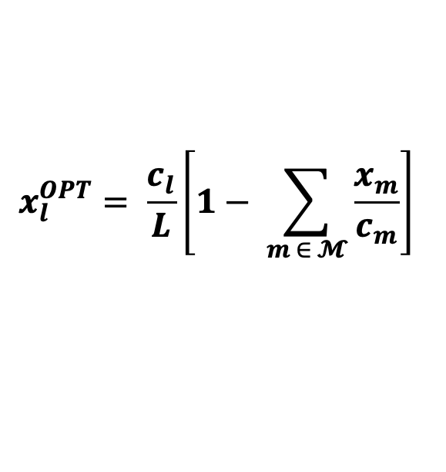
Design of Sneaker
Optimal dropping rate
$$x_{l}^{TCP}= \frac{B}{T_{l}}\sqrt{\frac{(1−q_{l})ρ_{l}}{β(1−(1−q_{l})ρ_{l})}}$$
$$x_{l}^{OPT}= \frac{c_{l}}{L}\left[1− \sum_{m ∈ 𝓜}{\frac{x_{m}}{c_{m}}}\right]$$
$$q_{l}^{OPT}=1−\frac{γ{(c_{l}T_{l}(1−τ_{F}))}^{2}}{ρ_{l}(1+γ{\left(c_{l}T_{l}\left(1−τ_{F}\right)\right)}^{2})}$$
$$τ_{F}=\sum_{m ∈ ℳ}{\frac{x_{m}}{c_{m}}}$$
$$γ= \frac{β}{L^{2}B^{2}}$$
  Practical drawback of the optimal dropping rate
$$τ_{F}=1$$
$$q_{l}^{OPT} =1$$
Drop every packet
Transmission stop

Slide 13
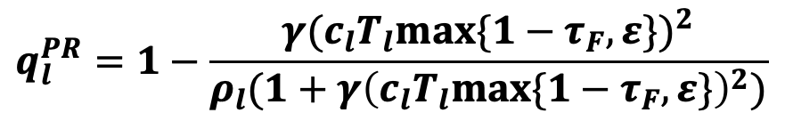
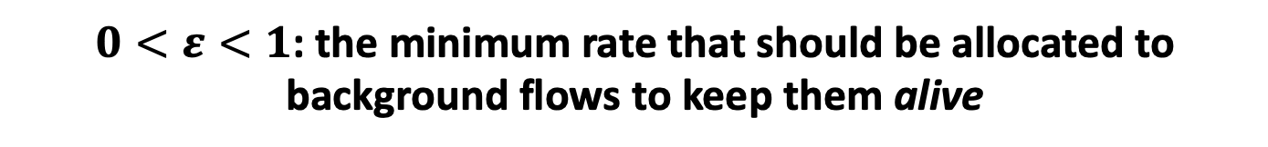
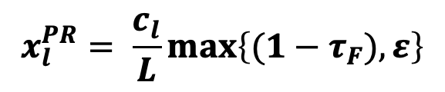
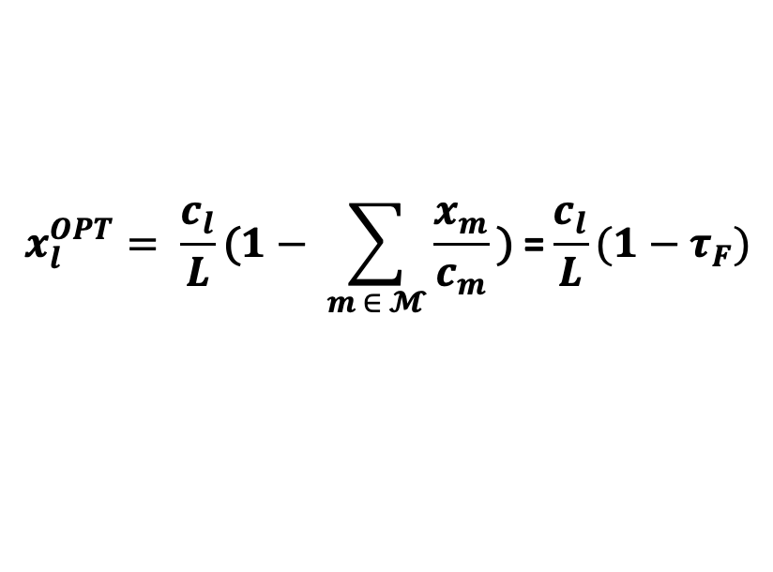
Design of Sneaker
Practical dropping rate
$$x_{l}^{OPT}= \frac{c_{l}}{L}\text{(}1− \sum_{m ∈ 𝓜}{\frac{x_{m}}{c_{m}}}\text{)} \text{=}\frac{c_{l}}{L}(1−τ_{F})$$
Recall
$$x_{l}^{PR}= \frac{c_{l}}{L}max\left\{(1−τ_{F}),ε\right\}$$
$0<ε<1$: the minimum rate that should be allocated to background flows to keep them alive
Practical dropping rate
$$q_{l}^{PR}=1−\frac{γ{(c_{l}T_{l}max⁡\{1−τ_{F},ε\})}^{2}}{ρ_{l}(1+γ{\left(c_{l}T_{l}max⁡\{1−τ_{F},ε\}\right)}^{2})}$$

Slide 14
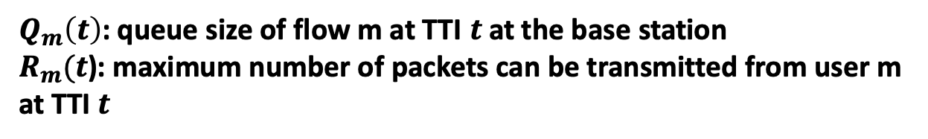

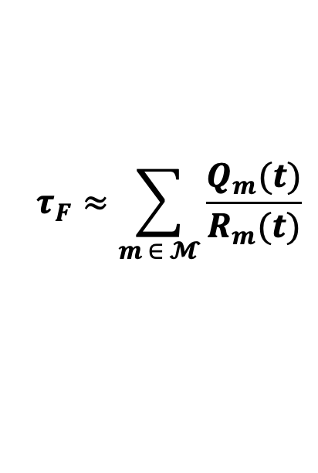
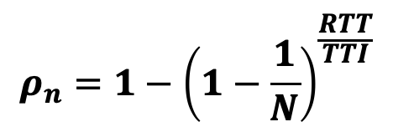
Implementation of Sneaker
Design parameters and signaling
Scheduling probability:
$$ρ_{n}=1−{\left(1−\frac{1}{N}\right)}^{\frac{RTT}{TTI}}$$
Proportional Fair Scheduler (PFS):
Local signaling:
$$τ_{F}≈\sum_{m ∈ 𝓜}{\frac{Q_{m}(t)}{R_{m}(t)}}$$
$Q_{m}\left(t\right)$: queue size of flow m at TTI $t$ at the base station
$R_{m}(t$): maximum number of packets can be transmitted from user m at TTI $t$
End-to-end signaling:
$$…$$
TCP header
Priority tag
RTT
Notes:
1) Scheduling probability: The packet dropping probability in Eq. (5) is a function of l, which is the packet scheduling probability at the base station and depends on the scheduling algorithm. The packet scheduling probability can be measured by the scheduler and passed to Sneaker to calculate the packet dropping probability. Furthermore, we can characterize the scheduling probability analytically for common schedulers. For example, the scheduling probability is expressed as XXX for PFS. (Note that we omit mathematical calculations due to space constraints.) Similar analysis can be performed for other schedulers including MT, RR, BET, and TTA.
2) Local signalling: The packet dropping rate in Eq. (5) depends on scheduling parameters such as the time share of
foreground traffic F , capacity of background user cl, and the number of background flows L. We approximate the time share of foreground traffic as m2M(Qm(t)=Rm(t)), where Qm(t) is the queue size of foreground user m in the base station at TTI t,
and Rm(t) is the maximum number of packets that can be transmitted from foreground flow user m at TTI t. The main idea behind this approximation is that both xm=cm and Qm(t)=Rm(t) are time shares, and we conjecture that the time average of Qm(t)=Rm(t) approaches xm=cm. Qm(t) and Rm(t) are collected by existing scheduling algorithms (such as PFS) and passed to Sneaker. Similarly, the scheduler passes Rl(t) information to Sneaker, and we make cl Rl(t) approximation.
3) End-to-end signalling: As for the access of other parameters, in our implementation, sender adds one bit as a tag in its TCP header to mark its classification (foreground or background). Sender also piggybacks the RTT information into its TCP header. At the base station, Sneaker extracts TCP header to obtain RTT and classification of the flow. In this way, Sneaker obtains Tl and learns if a flow is a background flow (hence the total number of background flows L).

Slide 15
Implementation of Sneaker on ns3
UE
eNodeB
Sneaker
PDCP
PDCP
RLC
RLC
MAC
MAC
PHY
PHY
Radio interface
Notes:
We implemented and evaluated Sneaker using the ns-3 simulator [9]. We build on top of existing LTE protocol stack shown in Fig. 3, where data packets are buffered in Radio Link Control (RLC) layer after passing through Packet Data Convergence Protocol (PDCP) layer. MAC layer reads packets in RLC buffers depending on the scheduling algorithm used Sneaker, implemented at eNodeB as a slim layer on top of PDCP, inspects every incoming packet, and extracts end-toend information. It also gets local signalling data from RLC and MAC layers to calculate the packet dropping probability using Eq. (5). Packets are dropped by Sneaker according to the calculated packet drop probability before arriving to PDCP. Note that we also make minimal updates to TCP so that packets carry end-to-end information.

Slide 16
Evaluation of Sneaker
Simulation topology
751 MHz downlink band with 10 MHz bandwidth and 50 resource blocks at base station
MIMO transmission with transmission power of 47.78 dBm
512 KB RLC buffer size
Log distance propagation model with loss exponential parameter of 3.52

Slide 17
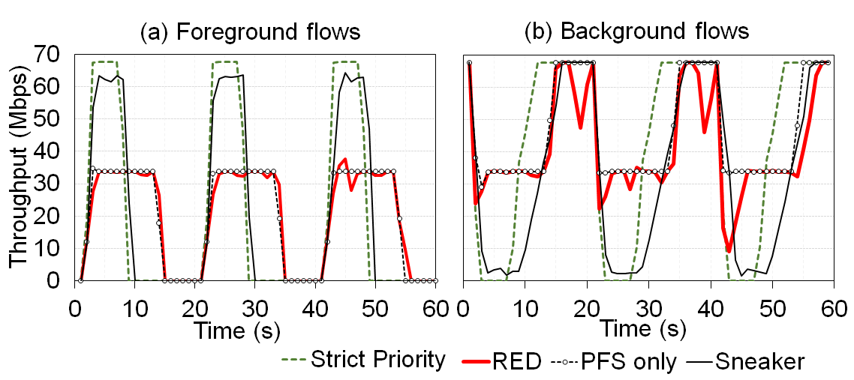
Evaluation of Sneaker
Prioritization
Sneaker yields to foreground flows and serves background
flows if no foreground flows present

Slide 18
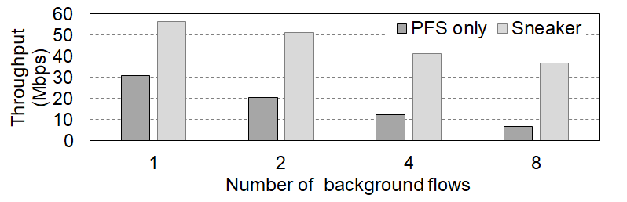
Evaluation of Sneaker
Prioritization
Foreground flows achieve higher throughput with Sneaker

Slide 19
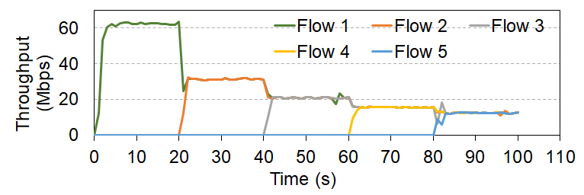
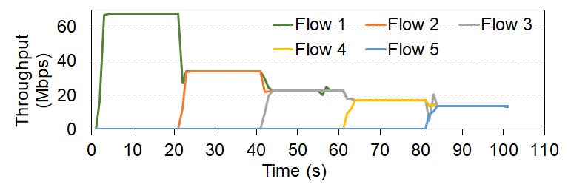
Evaluation of Sneaker
Fairness
Fairness among foreground flows
Fairness among background flows

Slide 20
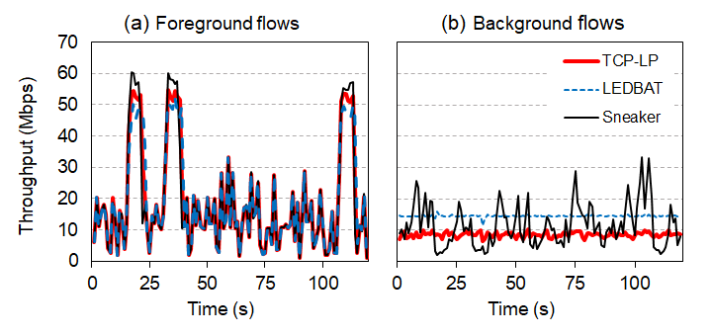
Evaluation of Sneaker
Large scale simulations at moderate load (50%)
100 users, various sizes of foreground flows, overall foreground traffic load is 50%
Sneaker achieves the best foreground throughput

Slide 21
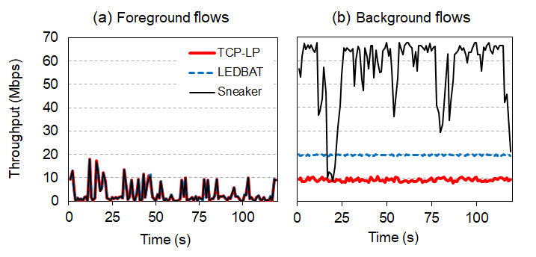
Evaluation of Sneaker
Large scale simulations at low load (20%)
100 users, various sizes of foreground flows, overall foreground traffic load is 20%
Sneaker achieves the best background throughput

Slide 22
Conclusion
Goal
Prioritize foreground traffic over background
Sneaker
Packet dropping via NUM and TCP rate formulation
Focus
In-network controller at base stations
Evaluation
Improves throughput, provides fairness

