Slide 1
ICON: Incast Congestion Control using Packet Pacing in Datacenter Networks
Hamed Rezaei, Muhammad Usama Chaudhry, Hamidreza Almasi, and Balajee Vamanan

Slide 2
Datacenter applications and traffic
Datacenters → de facto platform to access Internet data
host diverse applications with varying traffic characteristics
Foreground applications
respond to user queries
e.g., Web search, Social networks
short flows (e.g., < 16 KB)
sensitive to tail latency
Background applications
data replication, sync., update
e.g., Web index generation
long flows (e.g., > 10 MB)
require high throughput

Slide 3
Incast congestion
Foreground applications perform distributed lookup of small objects
query sent to 100s -- 1000s of servers
Responses are somewhat synchronized
responses collide at receiver → incast congestion
Incast causes queue buildup & packet drops
affects both tail latency and throughput
TCP too slow to avoid queue buildup
Incast drastically affects tail latency and throughput in datacenter applications

Slide 4
Existing schemes
Reactive congestion control (ECN based)
ICTCP [CoNEXT ’10], DCTCP [SIGCOMM ’10]
challenge: response time ~ incast duration → too slow
small ECN threshold or aggressive response to ECN → throughput loss
Centralized schemes (e.g., FastPass) do not scale
Load balancing
existing proposals achieve perfect load balancing
incast still causes packet drops
Existing schemes inadequate to handle incast

Slide 5
ICON: contributions
ICON proactively targets incast
leverages application knowledge to set rates
ICON enforces rate at a fine grain (i.e., per packet)
leverages existing NIC support for pacing
Nearly eliminates packet drops
Readily deployable
ICON improves 99th percentile flow completion times by 80% and throughput by 20% over ICTCP

Slide 6
Outline
Datacenter applications and traffic
Incast congestion
Existing approaches
ICON: contributions
Opportunity
ICON Design
Methodology
Results
Conclusion

Slide 7
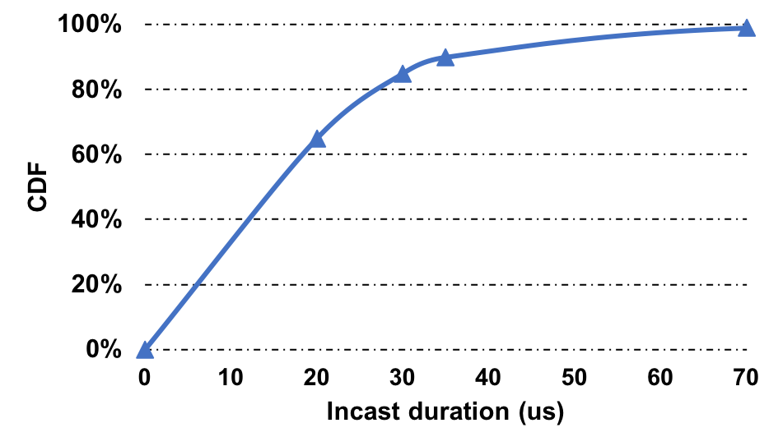
Opportunity
How fast do buffers fill up?
From our Web Search workload ….
*High-Resolution Measurement of Data Center Microbursts-(IMC ’17)) reported similar results
Incast requires proactive, sub-RTT rate control

Slide 8
Outline
Datacenter applications and traffic
Incast congestion
Existing approaches
ICON: contributions
Opportunity
ICON Design
Methodology
Results
Conclusion

Slide 9
ICON: Design
Two parts
Determine rate proactively
use application knowledge: Query initiator knows the numbers of concurrent senders (servers)
initiator tells senders the appropriate fair share rate, assuming network is not bottleneck
insight: congestion often at the edge!
Pace packets
enforces rate at packet granularity
existing NICs support per-packet pacing
Proactive rate control + pacing drastically reduces queuing
~5x lower queue length
Notes:
OVERAL
packets that are more likely to fall in the tail often incur congestion at multiple points in the network

Slide 10
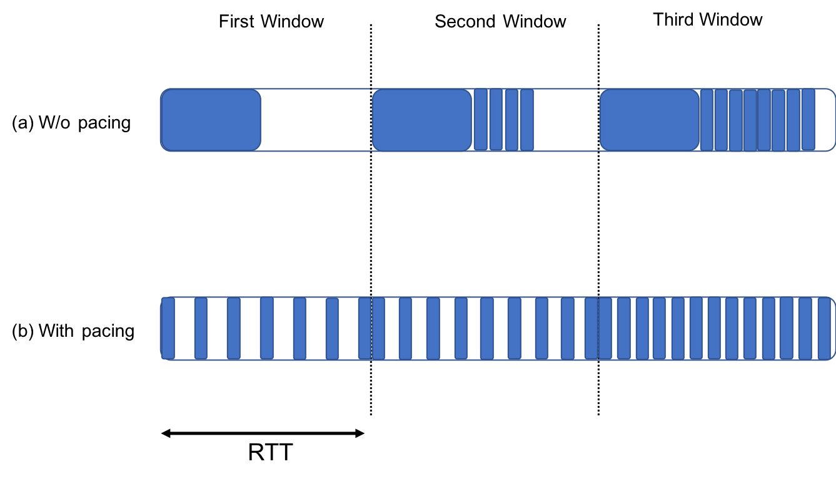
ICON: Pacing
Pacing is not a new idea …
But NIC support for pacing is new!
gap!
gap!
S1

Slide 11
ICON: Implementation
Pacing
Workers put appropriate gap between sending each packet
Computed based on desired rate and RTT
Naïve s/w implementation disables NIC offloads
Today’s NICs implement pacing logic on dequeue
Number of concurrent senders
Request uses unused VLAN bits; 8-12 bits sufficient
If unknown, set to 1 (= no rate control, only pacing)
even an application agnostic version of ICON improves over competition
Details in the paper

Slide 12
Outline
Datacenter network objectives
Existing proposals
Our contributions
Idea and Opportunity
ICON Design
Methodology
Results
Closing remarks

Slide 13
Simulation Methodology
Network simulator (ns-3 v3.28)
Transport protocol
DCTCP as underlying congestion control
Workloads
Short flows (8 - 32 KB) (web search workload)
long flows (1 MB) (data mining)
Schemes compared
ICTCP
DCTCP
Notes:
Mixed of sh and l flows

Slide 14
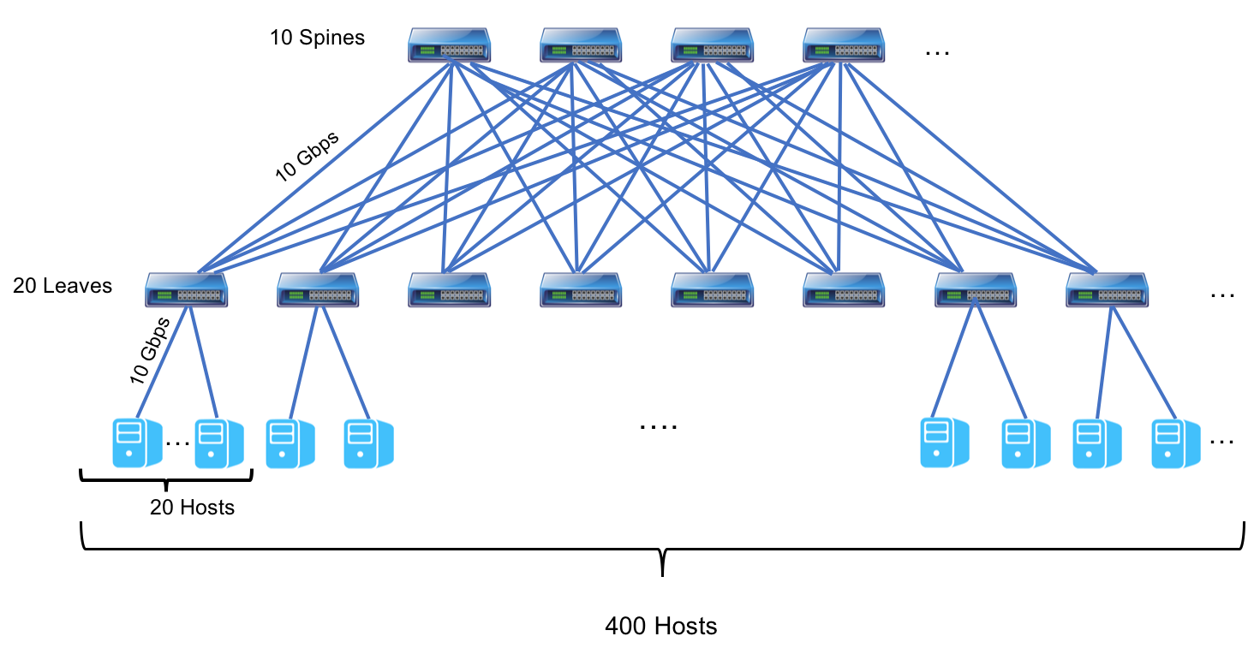
Topology
Two level, leaf-spine topology
400 hosts through 20 leaf switches
Connected to 10 spine switches in a full mesh manner
Notes:
Typical in today dc

Slide 15
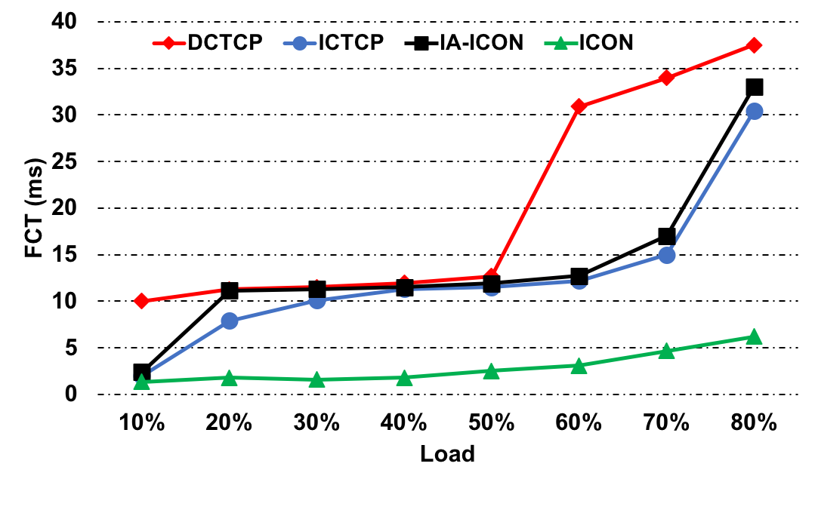
Tail (99th) percentile FCT
ICON achieves 77% lower 99th percentile
flow completion times for short flows

Slide 16
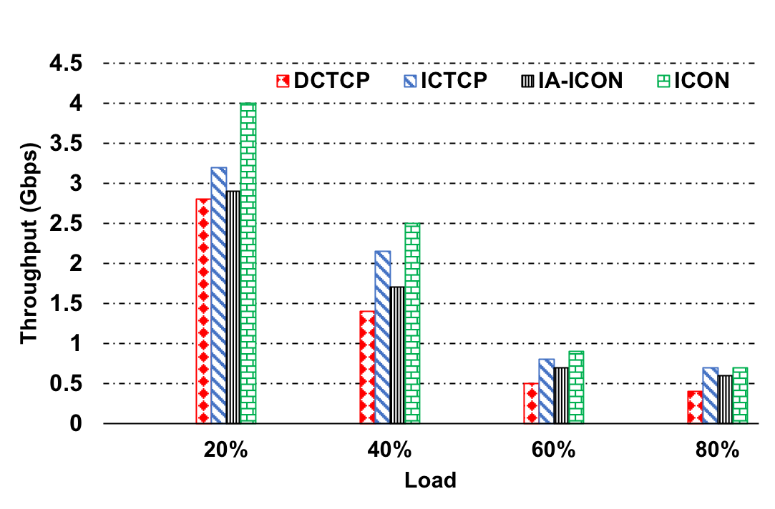
Average throughput (long flows)
ICON achieves 18% higher throughput for long flows
than ICTCP

Slide 17
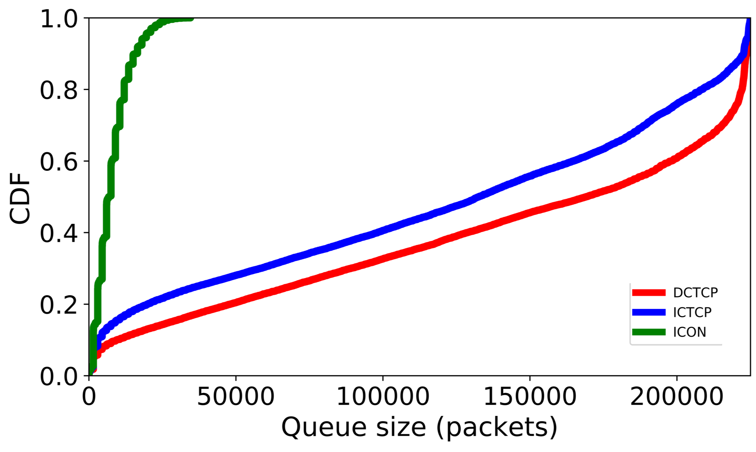
CDF of queue length in switches
Load =60%
Load =60%
ICON significantly reduces 99th percentile queue
length in switches by about a factor of 5x on average

Slide 18
Conclusion
Prior approaches
Reactive, leverage ECN to detect general congestion
too slow for incast
ICON isolates incast congestion
Uses application knowledge to calculate sending rate
Paces packets at the sender NIC
Improves both tail latency and throughput
Incast remains an open problem → need schemes that isolate incast from other general forms of congestion

Slide 19
Questions?

