Slide 1
Hydra: Leveraging Functional Slicing for Efficient Distributed SDN Controllers
Yiyang Chang, Ashkan Rezaei, Balajee Vamanan, Jahangir Hasan, Sanjay Rao and T. N. Vijaykumar

Slide 2
SDN is becoming prevalent
Software defined Networking (SDN) becoming prevalent in datacenter and enterprise networks
Centralized state → Fine-grained management
high network utilization
Wide adoption in industry WANs
Google (B4, SIGCOMM ‘13)
Microsoft (SWAN, SIGCOMM’13)
Consolidate state at a central controller
Single physical controller for small networks
Distributed implementation for large networks

Slide 3
Heterogeneity in SDN applications
SDN applications place varying demands on underlying machine
Real-time: periodically refresh state
e.g., heart-beats, link manager
deadline driven, light load
Latency-sensitive: invoked during flow setup
e.g., path lookup, bandwidth reservation, QoS
latency sensitive, medium load
Computationally-intensive: triggered during failures
e.g., shortest path calculation
affect convergence, heavy load
Distributed controller must handle both network size and application heterogeneity

Slide 4
Previous work: topological slicing
Conventional approach: topological slicing
partition network topology: one physical controller for each network partition
all network functions run in each partition
one-size-fits-all: all apps use same partition size
Topological slicing co-locates all applications
Computationally-intensive apps susceptible to load spikes
affects co-located real-time/latency-sensitive apps
Administrative constraints on partition sizing
topological slicing is agnostic of application heterogeneity and does not scale well

Slide 5
Hydra’s contributions
Functional slicing: split control plane applications across servers
adds new dimension to partitioning, more freedom for placement
Increase latency if critical paths span multiple servers
Communication-aware placement
cast as optimization problem
multi-constraint graph partitioning
Shields real-time apps from other apps
uses thread prioritization
Hydra shows better performance for each app category and scales better than topological slicing

Slide 6
Outline
Introduction
Background
Hydra
Goals
Functional slicing
Hybrid of functional and topological slicing
Communication-aware placement
Key results
Conclusion

Slide 7
Topological slicing
Network is partitioned into multiple controller domains
Each controller instance hosts all control-plane apps
but handles events only from switches in its partition
Server 2
f1() f2() f3() f4()
Server 1
Server 4
f1()
f2()
f3()
f4()
f1()
f2()
f3()
f4()
Partition 1
Partition 2
Partition 3
Partition 4
f1() f2() f3() f4()
Server 3

Slide 8
Shortcomings of topological slicing
Sustainable throughput limited
compute/memory capacities of server must be sufficient to handle all apps
Possible solution: increase # of partitions
Increasing # of partitions causes other problems
Worsens convergence
time to recalculate paths during link/switch failure
Slow updates → Write-heavy apps suffer
Topological slicing co-locates all apps → requires higher # of partitions → affects scalability

Slide 9
Outline
Introduction
Background
Hydra
Goals
Functional slicing
Hybrid of functional and topological slicing
Communication-aware placement
Key results
Conclusion

Slide 10
Hydra: goals and techniques
Partitioning must help scalability without worsening state convergence
Functional slicing
Place applications without worsening latency
Communication-aware placement
Isolate real-time applications from load spikes
prioritize real-time apps over other apps

Slide 11
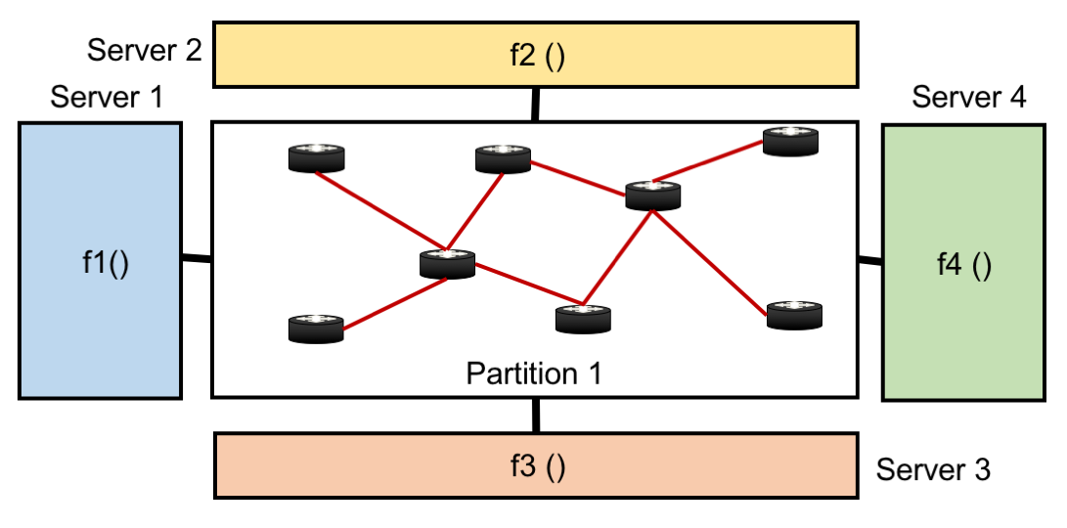
Functional slicing
Split control-plane apps among multiple servers
Better convergence (apps have complete network state)
Increases latency for events spanning >1 app
e.g., handling a packet-in might could involve inter-controller communication
lkvnclkn

Slide 12
Communication-aware placement
Step-0: find partition size based on critical app(s)
Typically, topology application is critical
Determine app slice <> server mapping
Objective: minimize latency
subject to capacity and communication constraints
Inputs
applications’ CPU, memory demand
aggregate server CPU and memory capacity
communication graph
compute-intensive apps (e.g., topology app) placed in separate machines to avoid interference
Mathematical formulation in the paper

Slide 13
Communication-aware placement (cont.)
An instance of multi-constraint graph partitioning
a known NP hard problem
use existing heuristics to solve in reasonable time
f1
f3
f2
f4

Slide 14
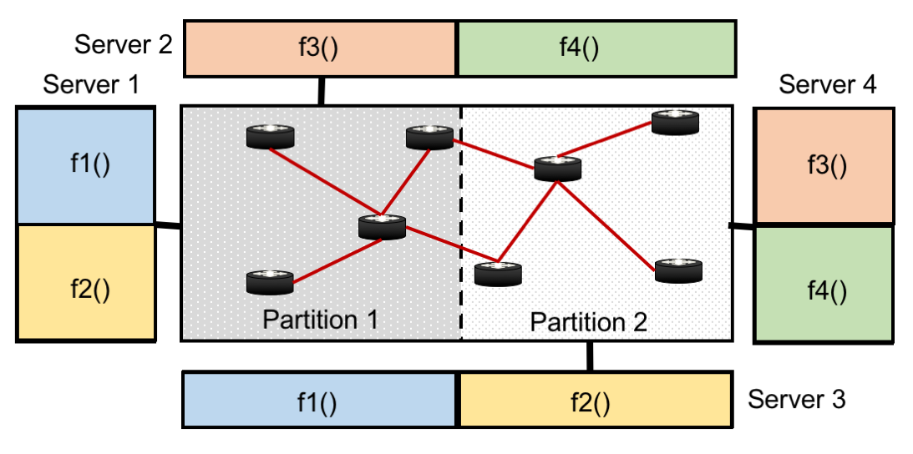
Hydra’s approach: hybrid of functional and topological slicing
hybrid of topological and functional slicing
Communication-aware placement achieves better convergence without increasing latency

Slide 15
Odds and ends
Our model can be extended to accommodate
dynamic load changes
replicated controllers (fault tolerance )
Details in the paper

Slide 16
Outline
Introduction
Background
Hydra
Goals
Functional slicing
Hybrid of functional and topological slicing
Communication-aware placement
Key results
Conclusion

Slide 17
Methodology
Floodlight controller
Apps
Dijkstra's shortest path computation (DJ)
Firewall (FW)
Route lookup (RL)
Heartbeat handler (HB)
Modified CBench → load generation
Mininet models control plane → doesn’t scale
Topology
Datacenter network → fat-tree
~2500 switches

Slide 18
Convergence time
Func. slicing
Topo. slicing
Topological slicing requires higher # partitions → worsens convergence

Slide 19
CPU demand
DJ’s demand depends on # partitions; other apps sensitive to network load (packet-in)

Slide 20
Placement results
Available capacity: 4 servers, 4 cores per server
Topological partitioning co-locates all apps → requires >= 16 partitions
16 partitions = 16 controller instances = one per core
Functional slicing reduces demand → Hydra requires fewer than 16 partitions (i.e., 8)
each partition hosts two controller instances
Packet-in pipeline: communication between RL and FW → one for DJ, one for {RL, FW, HB}
HB is prioritized over other apps

Slide 21
Hydra’s scalability
Hydra scales better than topological slicing by isolating compute-intensive apps from other apps

Slide 22
Real-time performance
Hydra’s thread prioritization isolates heart-beats from other apps

Slide 23
Conclusion
Hydra is framework for distributing SDN functions
Incorporates functional slicing
Communication-aware placement
Thread prioritization
Results show importance of Hydra’s key ideas
Future work
Infer communication graph using program analysis
Incorporate apps’ consistency requirements into model
Hydra’s gains potentially higher in large scale deployments

