Slide 1
FlowBender: Flow-level Adaptive Routing for Improved Latency and Throughput in Datacenter Networks
Abdul Kabbani (Google)
Balajee Vamanan (Purdue University)
Jahangir Hasan (Google)
Fabien Duchene (UCL, Belgium)

Slide 2
Motivation: why is multi-pathing inevitable?
Problem
Fragile & Severely bottlenecked
Hard
...
x 10,000's

Slide 3
Motivation
Solution
… but
Scalable

Slide 4
How are we doing today?
ECMP (Equal Cost Multi-Pathing)
Flow-level hashing (e.g. '5-tuple' hashing)
Works well in some cases, but...
It is those fewer big ones that practically make the problem harder

Slide 5
How are we doing today?
Example:
What happens if there are two large flows from the Sending ToR to the Receiving one?
Stage 2
ToRs
Stage 2a
Stage 2b
Sending ToR
Receiving ToR

Slide 6
How are we doing today?
ECMP:
What happens if a link fails?
Stage 2a
Stage 2b
Sending ToR
Receiving ToR
Fundamental issue: current ECMP routing is oblivious to congestion and link failures!

Slide 7
FlowBender

Slide 8
FlowBender's Rationale
From the perspective of a flow:
If (congestion is experienced || route is broken):
Try a different route
Let's parse this, in reverse:
1- How can a flow try a different route?
Hack the vlan tag field as an ECMP hashing input
Note: Maintain an independent vlan tag value per each TCP socket.

Slide 9
FlowBender's Rationale
From the perspective of a flow:
If (congestion is experienced || route is broken):
Try a different route
2- How can a TCP flow detect that a route is broken?
Timeouts (RTOs)

Slide 10
FlowBender's Rationale
From the perspective of a flow:
If (congestion is experienced || route is broken):
Try a different route
3- How can a TCP flow detect that a route is congested?
Explicit Congestion Notification (ECN)
Monitor if the fraction of ECN acks in a round trip > 10%
... but be patient (one RTT could be bursty, give it another try)
... persistent (new route still congested? try another one)
... and wise (don't over do it!)

Slide 11
Recap so far
Stage 2a
Stage 2b
Stage 2a
Stage 2b
Challenge:
Sending ToR
Receiving ToR
Sending ToR
Receiving ToR
Solution:
If (route is congested || route is broken):
Try a different route
Features:
Per-flow rerouting
End-to-end load balancing
Round-trip and RTO granularity
Quick reaction towards mild but sustained congestion
Little to no out-of-order packet delivery

Slide 12
Implementation
Host:
Congestion and link-failure detection and rerouting
Implemented as a Linux patch (~50 lines of critical code)
Switch (configuration only):
Configure vlans and/or the hashing function

Slide 13
Evaluation

Slide 14
Evaluation (Testbed)
Testbed:
~200 servers on 15 ToRs
2-stage fabric with 4 routes between any pair of ToRs
10Gbps
Workload:
All-to-all
1MB RPCs
Schemes:
ECMP
FlowBender

Slide 15
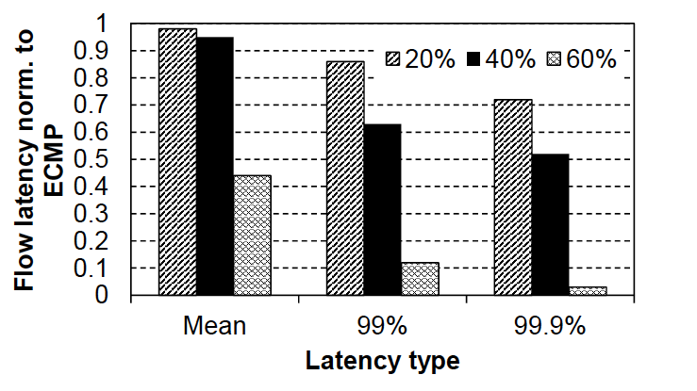
All-to-all (percentage of reduction in completion times, due to FlowBender)

Slide 16
Conclusion
FlowBender: a load balancing mechanism that improves latency and throughput in data centers
- Host-based (vs fabric-based)
- Flow-level (vs packet-level)
- Adaptive (vs oblivious)
- End-to-end signals (vs local congestion info)
- Readily deployable:
- Does not require custom hardware
- Suitable for general topologies
- Readily deployable (patch < 50 lines)

