Slide 1
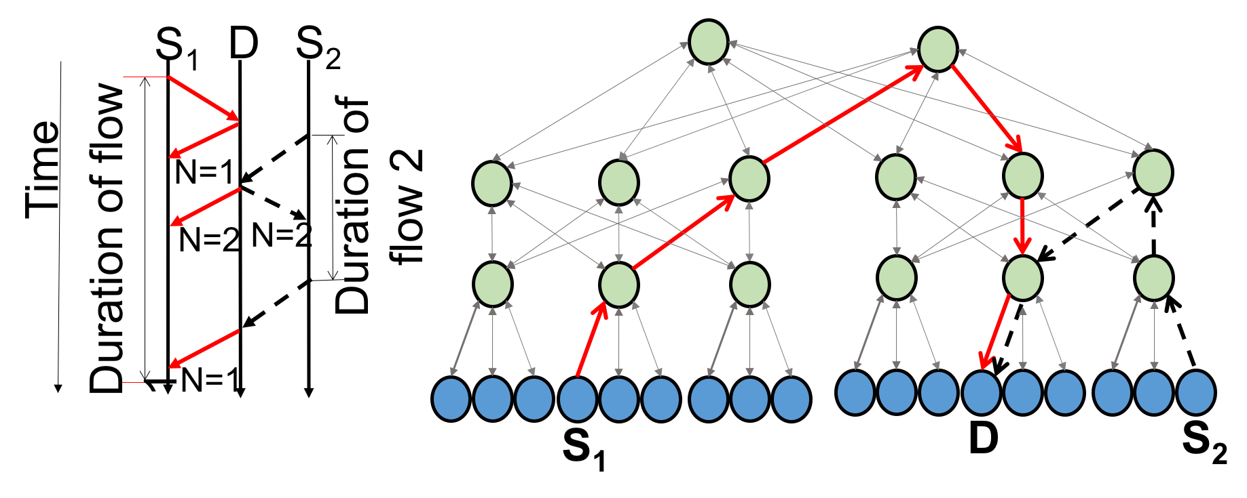
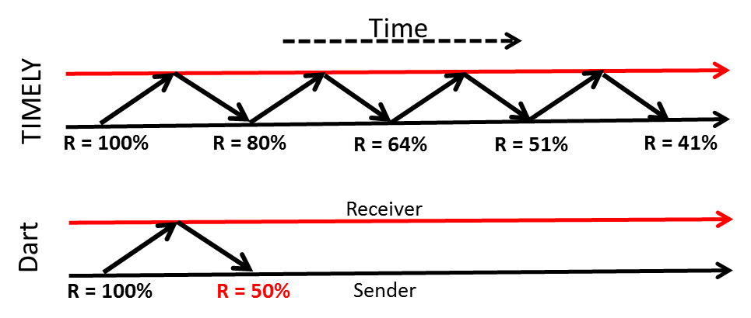
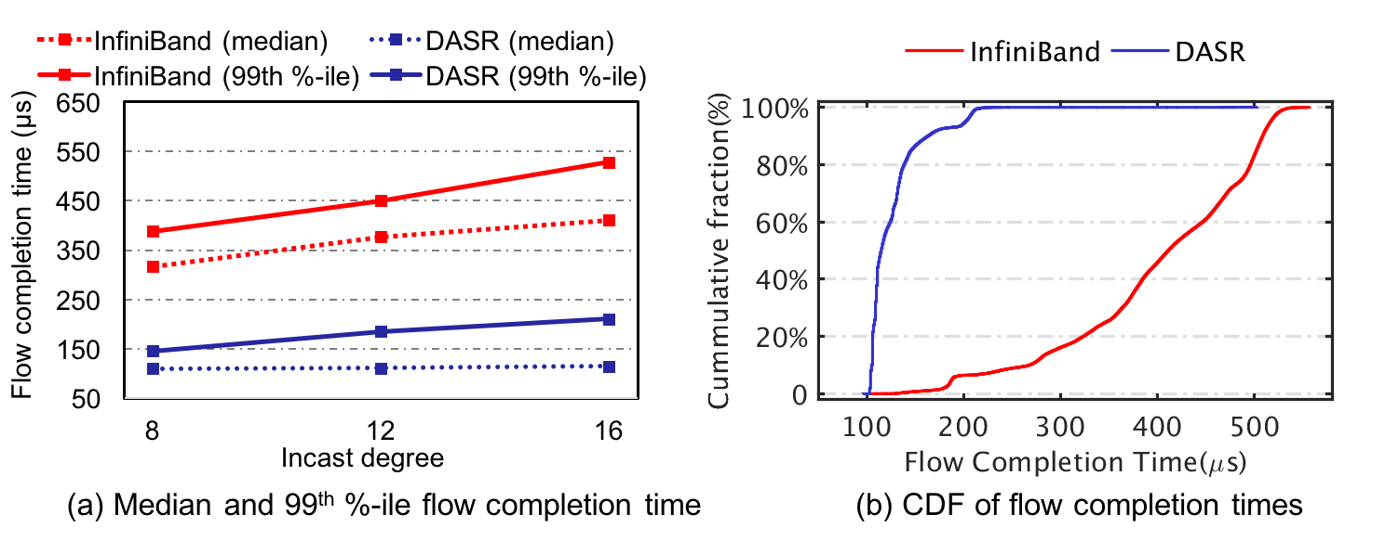
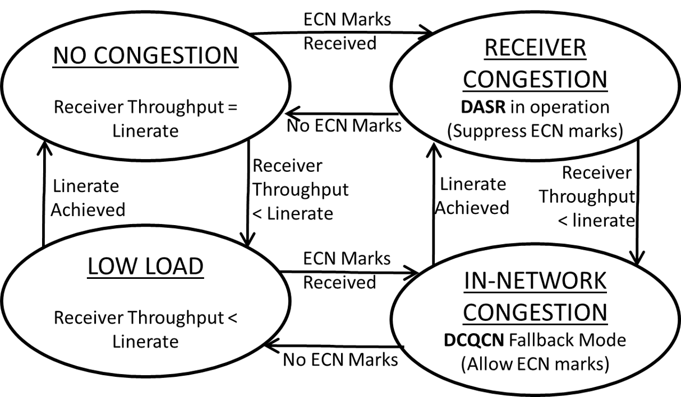
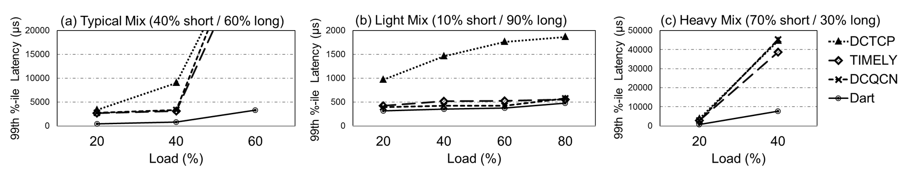
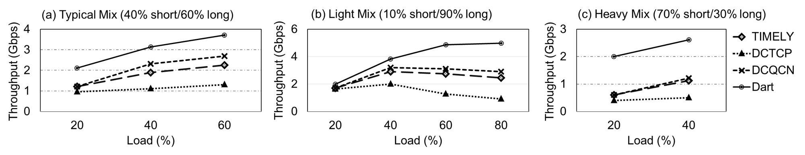
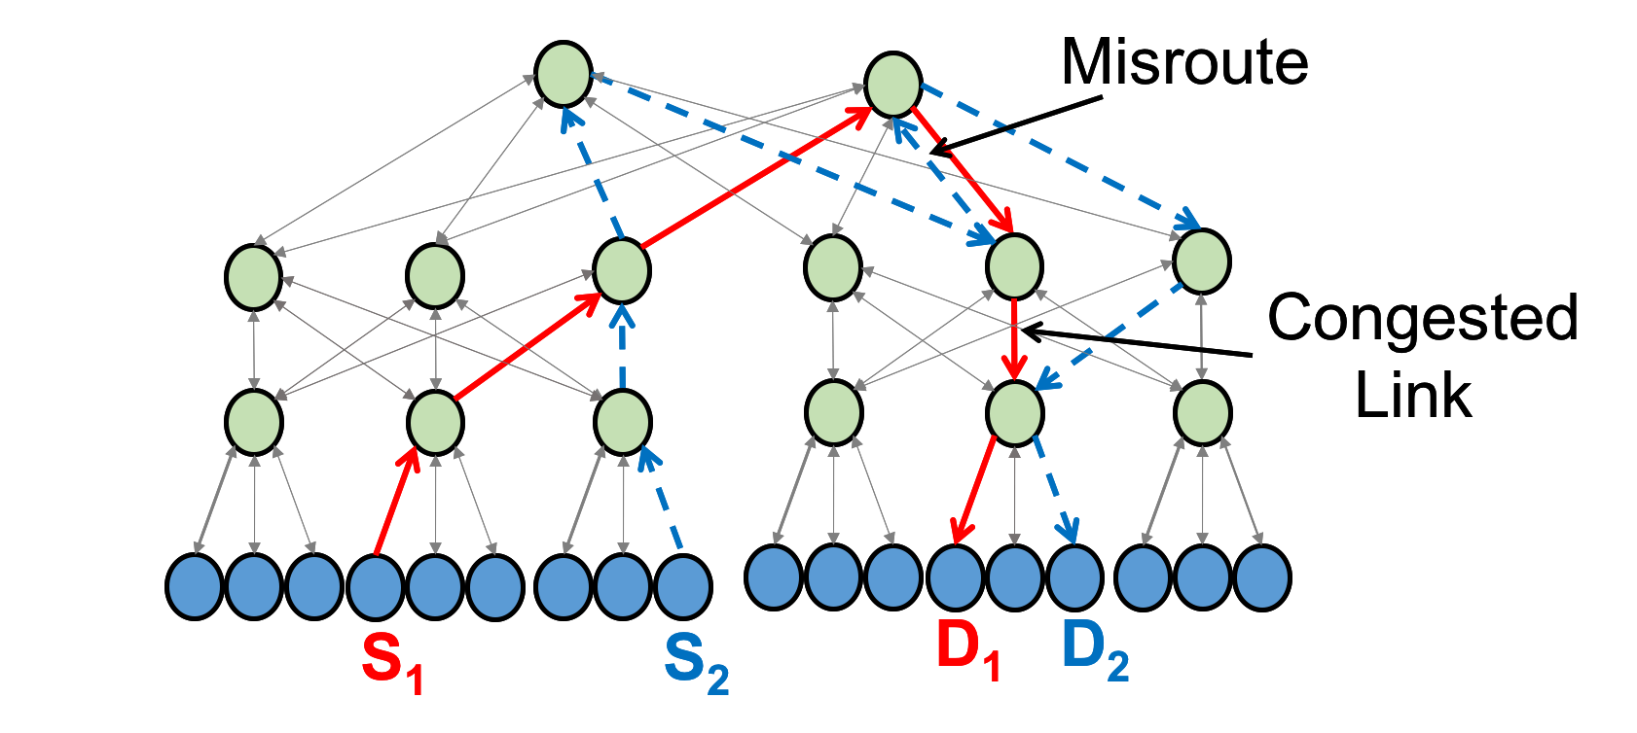
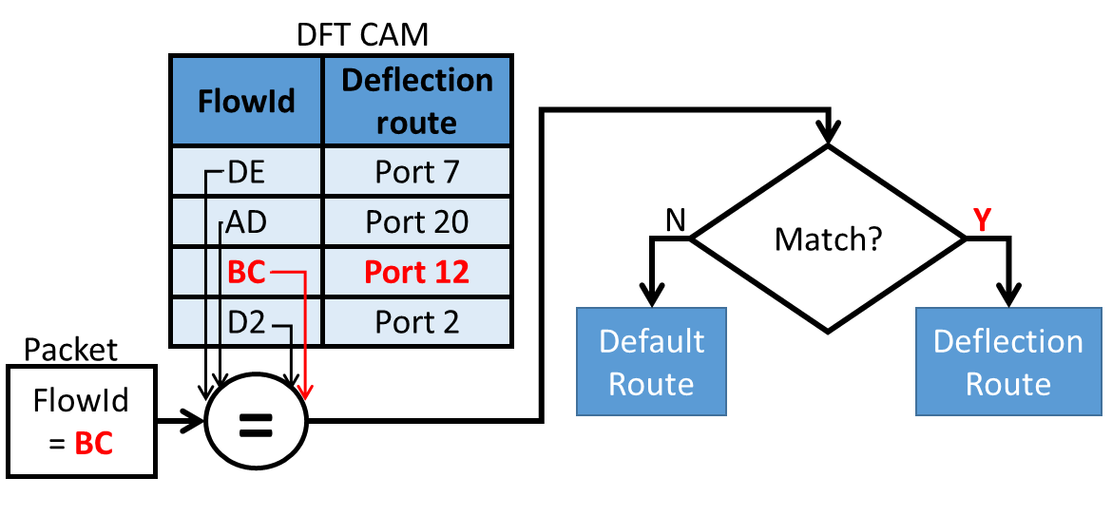

Fast Congestion Control in RDMA-Based Datacenter Networks
Jiachen Xue, Muhammad Usama Chaudhry, Balajee Vamanan,
Mithuna Thottethodi, and T. N. Vijaykumar
MOTIVATION
DASR
METHODOLODY
RDMA is becoming prevalent in datacenters
Direct apportioning of sending rates
Micro-benchmark (20 node test bed)
  each node equipped with eight 4-core AMD Opteron processors running at 2.8GHz, 256 GB of RAM
  Mellanox connectX-3 HCA (56Gbps)
Workload
  Micro-benchmark: synthetic workload with fixed size messages
RDMA shortens latency by a factor of 50 compared to TCP
  potential replacement for TCP in datacenters
Inefficiencies of existing RDMA networks
Provides hop-by-hop flow control and rate based end-to-end congestion control
  suboptimal for the well-known datacenter congestion problem, called incast
  where multiple flows collide at a switch causing queueing delays and long latency tails
Convergence can be slow
  Congestion control schemes react to congestion by
    Detecting congestion: RTT, ECN,
    Reacting to congestion: Throttle at senders; converge to desired rate over several iterations
At-scale simulations (ns-3)
  1024 hosts connected in an over-subscribed Clos topology with over-subscription factor of 4
Workload
  Based on real datacenter traffic characteristics
  sender continues to transmit at the line rate without throttling as it sees the ‘N=1’ in the Acks from the receiver.
  when a second sender initiates a flow to the same receiver, the receiver piggy-backs the updated ‘N=2’ value to each sender, throttling their rates to half of the line rate, which can be sustained in steady state.
MICRO-BENCHMARK RESULT
DART STATE MACHINE
State Machine to handle receiver and in-network congestion
Key Observation
DASR reduces the median and tails by 2.5 – 3.3x
While general congestion is complex and may require iterative convergence, the simpler and common case of receiver congestion can be addressed quicker via specialization.
AT-SCALE SIMULATIONS
99th Percentile of Short Flows
INTRODUCTION
  the absence of ECN marks and low receiver throughput requires no action
  line-rate achieved but no ECN marks indicates no contention at receiver
  receiver congestion handles by DASR by piggybacking the ’n’ values while omitting ECN marks
  the receiver throughput lower than the line-rate and presence of ECN marks indicates in-network congestion and DART falls back to DCQCN and include ECN marks in ACKs
DART reduces tail latency by 4.8x
Our proposal: Dart employs a divide-and-specialize approach to congestion control;
  Addresses receiver congestion via direct apportioning of sending rates by using the sender count to achieve accurate and faster, one-RTT convergence of sending rates than previous schemes which are iterative;
  Addresses spatially-localized in-network congestion via in-order flow deflection whereas previous schemes reorder packets which is not supported by RDMA.
Throughput of Long Flows
IN-ORDER FLOW DEFLECTION
DART achieves 58% higher throughput
DART deflects packets of short flows to avoid serialization penalty
CONCLUDING REMARKS
Dart converges to the desired sending rate in one RTT and achieves 60% (2.5x) lower latency than and similar throughput as InfiniBand
Dart divide-and-specialize approach isolates common case of receiver congestion and
  Further sub-divides the remaining in-network congestion into the simpler spatially-localized and the harder spatially-dispersed cases
PREVIOUS WORK
Packet routing with DFT lookup
maintains a small content-addressable memory (CAM) called deflected flow table (DFT) at each switch
entries in the DFT are allocated when the start packet of an RDMA message is chosen for deflection
Congestion Control:
  DCTCP modulates sending rate by observing ECN marks in each RTT
  DCQCN uses ECN marks and provides congestion control for RoCE
  Timely uses round-trip times (RTT) measurements for rate control
all these schemes needs many RTTs to converge to the appropriate sending rate
ABOUT THE AUTHORS
Entries in the DFT are deallocated when the end of an RDMA message passed through the switch
Jiachen Xue (xuej@purdue.edu)
  Ph.D. Student at Purdue University (ECE Department)
Muhammad Usama Chaudhry (mchaud30@uic.edu)
  MS Student at UIC (CS Department)
Balajee Vamanan (bvamanan@uic.edu)
  Assistant Professor at UIC (CS Department)
  https://www.cs.uic.edu/~balajee
Mithuna Thottethodi (mithuna@purdue.edu)
  Professor at Purdue University (ECE Department)
  https://engineering.purdue.edu/~mithuna
T. N. Vijaykumar (vijay@ecn.purdue.edu)
  Professor at Purdue University (ECE Department)
  https://engineering.purdue.edu/~vijay
Load Balancing:
  DIBS deflect packets randomly to avoid dropping of the packet
  DRILL distributes load at granularity of packets based on queues and randomization algorithm
  Hermes reroutes based on global congestion and failure
all these schemes require reordering mechanism at end-host but RDMA does not support packet reordering

